Slide 1
IT694 Computer Networks Week 6-Lec 1
TCP-Reliable transfer

Slide 2
Reliable Data Transfer: stop-and-wait operation
sender
receiver
L / R
=
L/R
U_{sender}
RTT
+ L / R
.008
RTT
=
30.008
=
0.00027
=
1000 bytes
Throughput
=
30.008 msecs
=
~300kbps

Slide 3
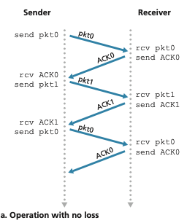
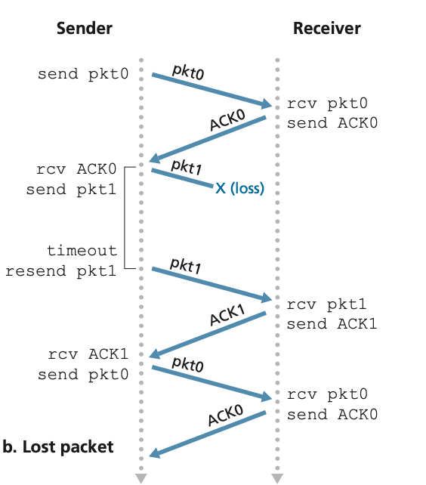
Stop and Wait – Alternating Bit Protocol

Slide 4
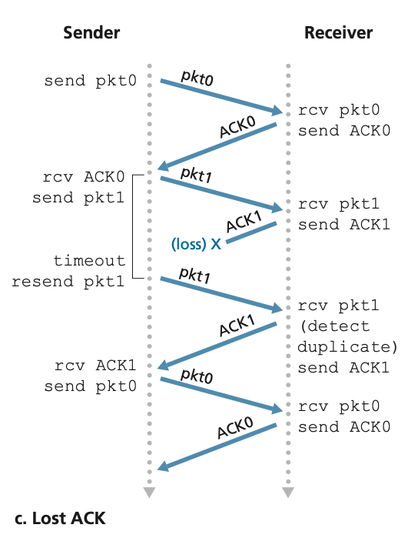
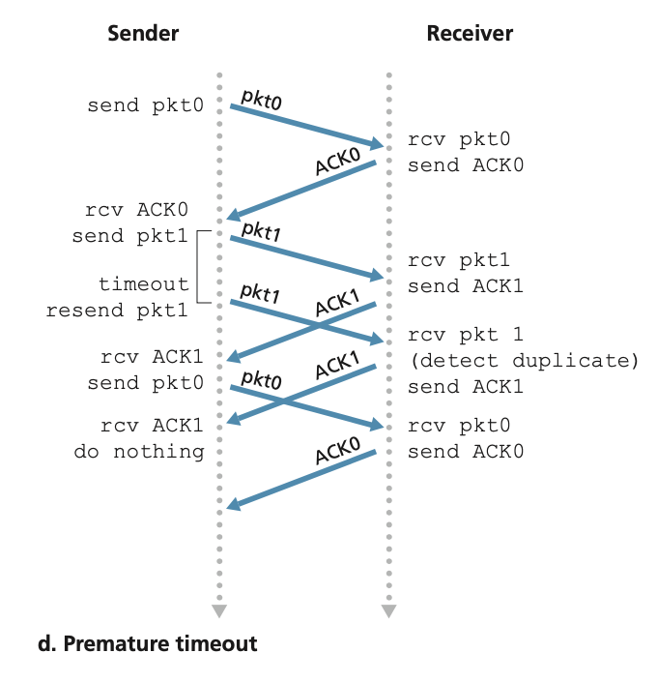

Slide 5
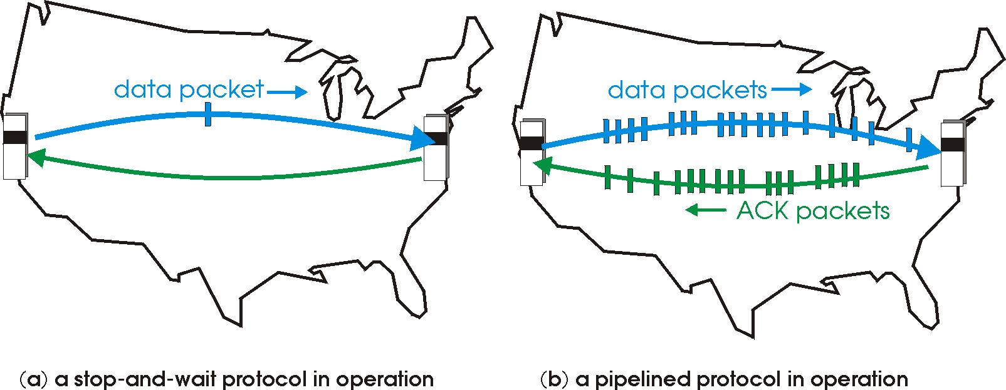

Reliable Data Transfer : pipelined protocols operation
pipelining: sender allows multiple, “in-flight”, yet-to-be-acknowledged packets
range of sequence numbers must be increased
buffering at sender and/or receiver

Slide 6
Pipelining: increased utilization
Because a well tuned sliding window protocol keeps the network completely saturated with packets, it obtains substantially higher throughput than a stop and wait
sender
receiver
first packet bit transmitted, t = 0
last bit transmitted, t = L / R
first packet bit arrives
RTT
last packet bit arrives, send ACK
last bit of 2nd packet arrives, send ACK
last bit of 3rd packet arrives, send ACK
ACK arrives, send next
packet, t = RTT + L / R
3-packet pipelining increases
utilization by a factor of 3!
Notes:
two generic forms of pipelined protocols: go-Back-N, selective repeat

Slide 7
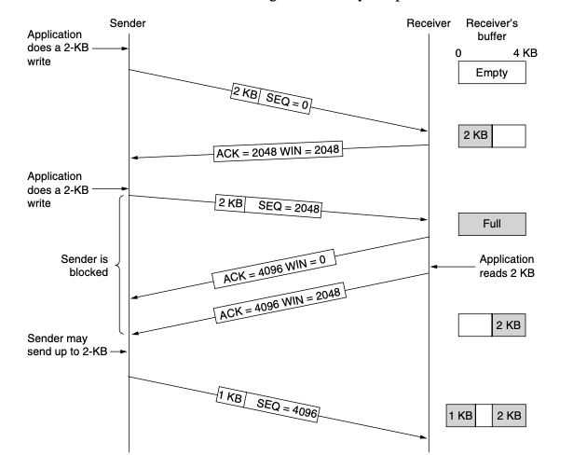
TCP Sliding Window
Receiver Window and Flow Control

Slide 8
TCP round trip time, timeout
Q: how to set TCP timeout value?
longer than RTT, but RTT varies!
too short: premature timeout, unnecessary retransmissions
too long: slow reaction to segment loss
Q: how to estimate RTT?
Meas_{RTT}:measured time from segment transmission until ACK receipt
ignore retransmissions
Meas_{RTT} will vary, want estimated RTT “smoother”
average several recent measurements, not just current value

Slide 9
TCP round trip time, timeout
EstimatedRTT = (1- α)*EstimatedRTT + α* Meas_{RTT}
exponential weighted moving average (EWMA)
influence of past sample decreases exponentially fast
typical value: α = 0.125
RTT: gaia.cs.umass.edu to fantasia.eurecom.fr
RTT (milliseconds)
Meas_{RTT}
EstimatedRTT
time (seconds)
Notes:
This is how TCP re-computes the estimated RTT each time a new SampleRTT is taken.
The process is knows as an exponentially weighted moving average, shown by the equation here.
<say it>
Where alpha reflects the influence of the most recent measurements on the estimated RTT; a typical value of alpha used in implementations is .125
The graph at the bottom show measured RTTs between a host in the Massachusetts and a host in France, as well as the estimated, “smoothed” RTT

Slide 10

TCP round trip time, timeout
timeout interval: EstimatedRTT plus “safety margin”
large variation in EstimatedRTT: want a larger safety margin
TimeoutInterval = EstimatedRTT + 4*DevRTT
estimated RTT
“safety margin”
DevRTT: EWMA of SampleRTT deviation from EstimatedRTT:
DevRTT = (1-β)*DevRTT + β*| Meas_{RTT} -EstimatedRTT|
(typically, β = 0.25)
* Check out the online interactive exercises for more examples: http://gaia.cs.umass.edu/kurose_ross/interactive/
Notes:
Given this value of the estimated RTT, TCP computes the timeout interval to be the estimated RTT plus a “safety margin”
And the intuition is that if we are seeing a large variation in SAMPLERTT – the RTT estimates are fluctuating a lot - then we’ll want a larger safety margin
So TCP computes the Timeout interval to be the Estimated RTT plus 4 times a measure of deviation in the RTT.
The deviation in the RTT is computed as the eWMA of the difference between the most recently measured SampleRTT from the Estimated RTT

Slide 11
Short Video
Packet tracer for TCP

Slide 12
Suppose that the three MeasuredRTT values are 106ms, 120ms, 140ms. Compute the EstimatedRTT after each of these MeasuredRTT values is obtained, using a value of alpha = 0.125 and assuming that the value of EstimatedRTT was 100ms just before the first of these 3 samples were obtained. Compute also the DevRTT after each sample is obtained, assuming a value of beta = 0.25 and assuming the value of DevRTT was 5ms just before the first of these three samples was obtained. Last, Compute the TCP TimeoutInterval after each of these samples is obtained.
EstimatedRTT = xSampleRTT + (1 - x ) EstimatedR TT
DevRTT = y SampleRTT - EstimatedRTT + (1 - y ) DevRTT
TimeoutInterval = EstimatedRTT + 4 * DevRTT
After obtaining first sampleRTT is EstimatedRTT = 0.125 * 106 + 0.875 * 100 = 100.75ms
DevRTT = 0.25 * 106 - 100.75 + 0.75 * 5 = 5.06ms
TimeoutInterval = 100.75 + 4 * 5.06 = 120.99ms
After obtaining second sampleRTT = 120ms:
EstimatedRTT = 0.125 * 120 + 0.875 * 100.75 = 103.15ms
DevRTT = 0.25 * 90 - 105.54 + 0.75 *14.06 = 14.42ms
TimeoutInterval = 105.54 + 4 *14.42 = 163.22ms
After obtaining Third sampleRTT = 140ms:
EstimatedRTT = 0.125 * 140 + 0.875 * 103.15 = 107.76ms
DevRTT = 0.25 * 140 - 107.76 + 0.75 * 8 = 14.06ms
TimeoutInterval = 107.76 + 4 *14.06 = 164ms

